Slide 1

Customer Shopping Behavior Analysis
Data Analysis using Python, SQL & Power BI

Slide 2
PROJECT OVERVIEW
Unveiling Customer Spending Patterns
1
2
Analyzed 3,900 transactions to decipher customer spending habits.
Identified customer segments and their unique product preferences.
3
4
Evaluated the impact of subscriptions on purchasing behavior.
Aimed at providing actionable insights for strategic business decisions.
This project delved into a vast dataset to uncover the intricate dynamics of customer shopping, offering a comprehensive view for informed business strategies.

Slide 3

DATA FOUNDATION
Dataset at a Glance
Our analysis was built upon a robust dataset, comprising 3,900 rows and 18 comprehensive columns. Each record provided a rich tapestry of customer interactions.
Demographic Insights: Age, gender, location.
Purchase Specifics: Product details, quantity, price, shipping.
Behavioral Metrics: Ratings, reviews, discount usage.
Missing values within the review rating column were meticulously handled, ensuring data integrity and reliability for subsequent analysis.

Slide 4

TECHNOLOGY STACK
Tools Driving Our Insights
Python
PostgreSQL
Power BI
Leveraged Pandas for data cleaning, feature engineering, and initial exploratory analysis.
Employed for storing cleaned data and executing complex SQL business queries.
Utilized to create interactive dashboards for dynamic data visualization and stakeholder engagement.

Slide 5

DATA PREPARATION
Streamlining Data for Accuracy
Key Preprocessing Steps
Null Value Imputation: Addressed missing review ratings by imputing with median values based on product categories.
Standardization: Ensured consistency by converting all column names to snake_case.
Feature Engineering: Created new 'Age Group' categories for better demographic analysis.
Redundancy Removal: Eliminated the 'promo_code_used' column due to data overlap with 'discount_applied'.
These meticulous preprocessing steps were crucial in preparing the raw transactional data for robust analysis in PostgreSQL.

Slide 6
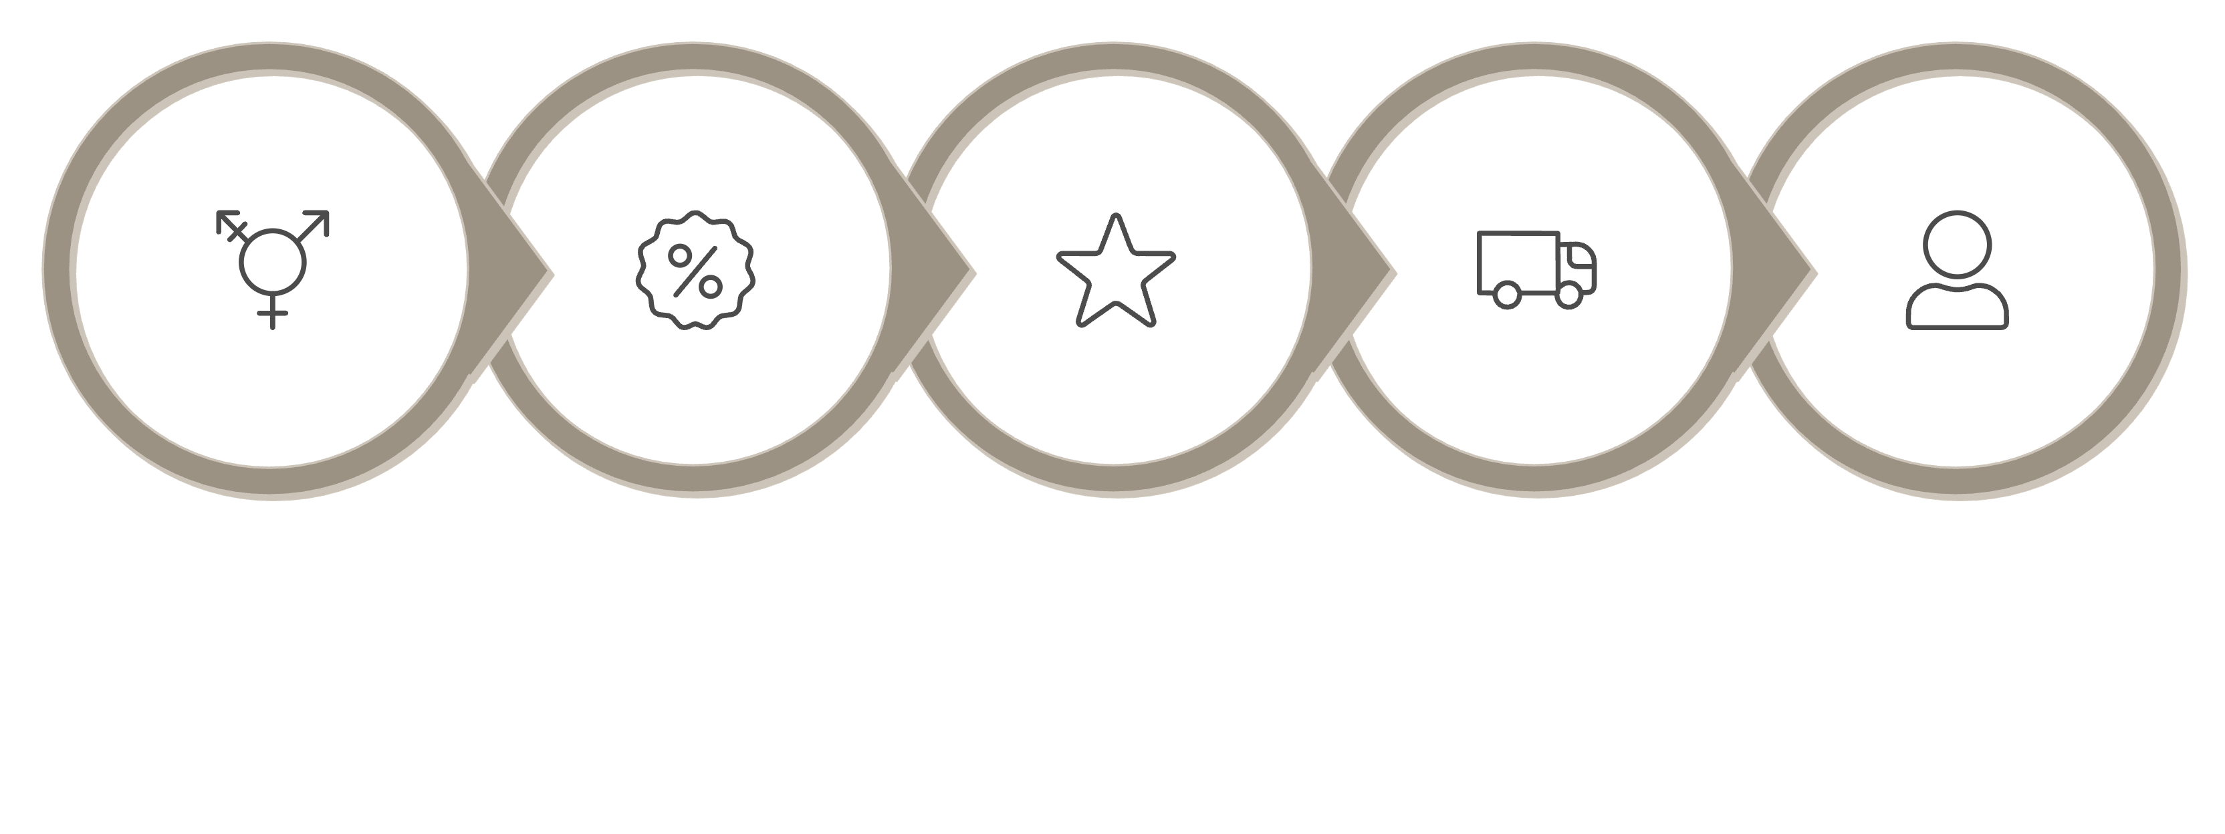
BUSINESS INSIGHTS
Unlocking Value with SQL Queries
High-Spend Discount Users
Shipping Type vs Amount
Revenue by Gender
Top-Rated Products
Subscriber Comparison
We formulated critical SQL business questions to extract actionable insights from the cleaned dataset, focusing on various facets of customer behavior. This allowed us to dissect performance across different dimensions.

Slide 7
KEY DISCOVERIES
Data-Driven Revelations
Loyal Customers Drive Growth
Express Shipping = Higher Spend
The loyal customer segment emerged as the largest and most valuable contributor to overall revenue.
Customers opting for express shipping exhibited a significantly higher average purchase amount.
Discounts: A Double-Edged Sword
Age Group Revenue
While effective, discounts don't always lead to reduced overall revenue; their impact varies by product.
Young adults (25-34) represented the highest revenue-generating demographic.
These insights highlight critical areas for strategic focus, from customer retention to promotional efficacy.

Slide 8
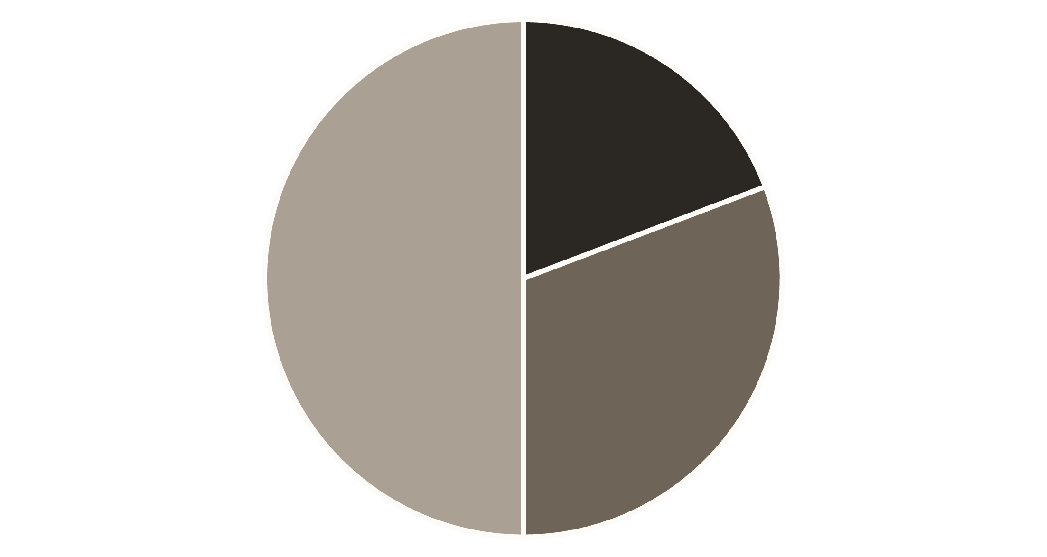
CUSTOMER SEGMENTATION
Understanding Our Customer Base
We segmented our customer base into three distinct groups: New, Returning, and Loyal customers. This segmentation allows for targeted marketing and engagement strategies, maximizing customer lifetime value.
New Customers: First-time buyers, crucial for acquisition strategies.
Returning Customers: Have made multiple purchases, indicating satisfaction and potential for loyalty.
Loyal Customers: Our most valuable segment, demonstrating consistent engagement and high repeat purchase rates.
New
Returning
Loyal

Slide 9
PRODUCT PERFORMANCE
Best-Selling and Highest-Rated Offerings
Top 3 Products by Category
Highest-Rated Products
Electronics: Smartwatch, Wireless Headphones, Drone
Clothing: Premium Jeans, Designer Dress, Winter Coat
Home Goods: Robotic Vacuum, Smart Lighting, Espresso Machine
Books: Bestselling Novel, Self-Help Guide, Children's Illustrated Book
Echo Dot (5.0 stars): Exceptional user satisfaction.
Noise-Cancelling Headphones (4.9 stars): Premium audio experience.
Organic Skincare Set (4.8 stars): Highly effective and popular.
Ergonomic Office Chair (4.7 stars): Comfort and quality praised.
Understanding both sales volume and customer satisfaction is vital for optimizing inventory and marketing efforts.

Slide 10





STRATEGIC RECOMMENDATIONS
Actionable Steps for Growth
Enhance Subscription Benefits
Introduce exclusive perks to boost subscriber engagement and retention.
Reward Loyal Buyers
Implement a tiered loyalty program to incentivize repeat purchases and brand advocacy.
Optimize Discount Strategy
Analyze discount effectiveness for specific products to maximize revenue without devaluation.
Target High-Revenue Demographics
Focus marketing efforts on age groups with proven high spending potential.
Promote Top-Rated Products
Highlight highly-rated products in marketing campaigns to leverage positive customer sentiment.

